Slide 1





AC-DC POWER SUPPLY DESIGN AND OSCILLOSCOPE CONSTRUCTION
EEE316 Group. 07
Name: MD. Asif hasan (1906114)
Md. Meraz Rahman (1906118)
Joydip Chakraborty (1906117)
Md. Mustansir billah (1906130)

Slide 2

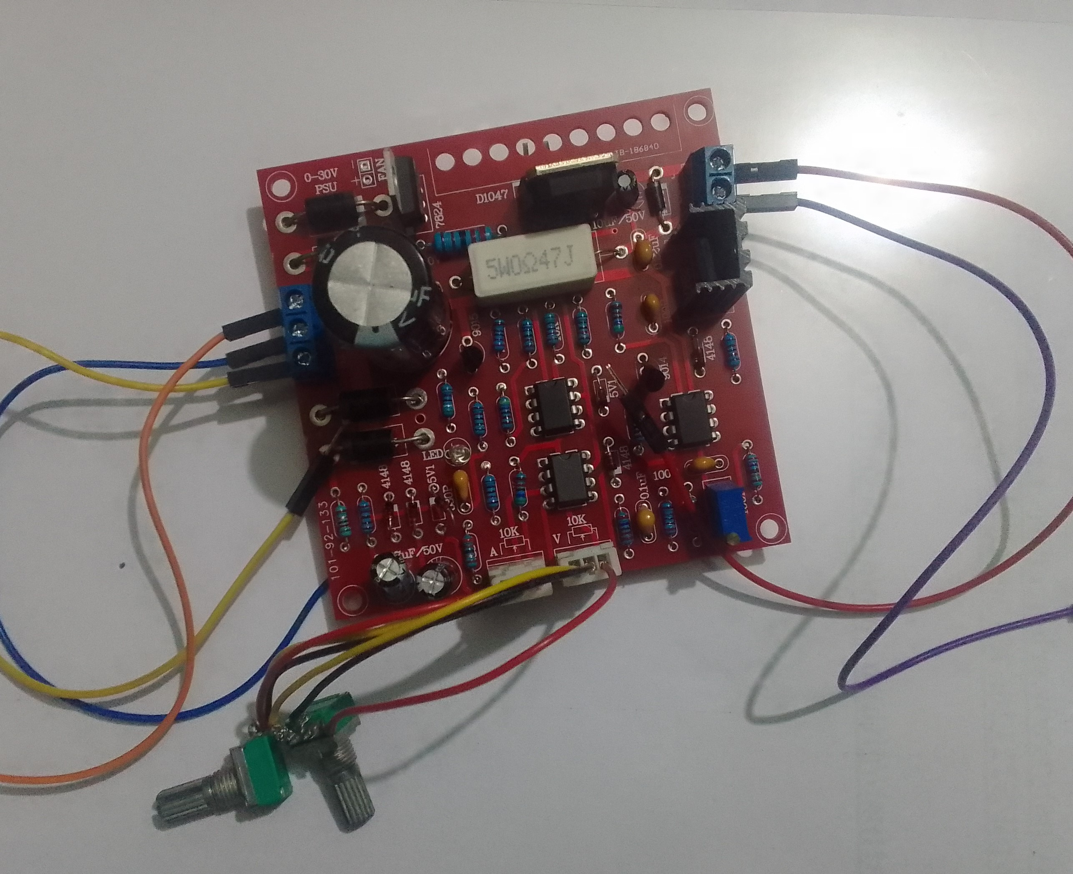
Introduction
This report delves into the meticulous creation of two pivotal tools for electronics enthusiasts and professionals alike: an adjustable DC regulated power supply and a high-performance oscilloscope
The DC power supply, with its variable output voltage range of 0-30V and adaptable current limits from 2mA to 3A, is a versatile laboratory instrument.
On the other hand, the oscilloscope, with its impressive analog bandwidth, sensitivity, and resolution, serves as an indispensable instrument for signal analysis.

Slide 3
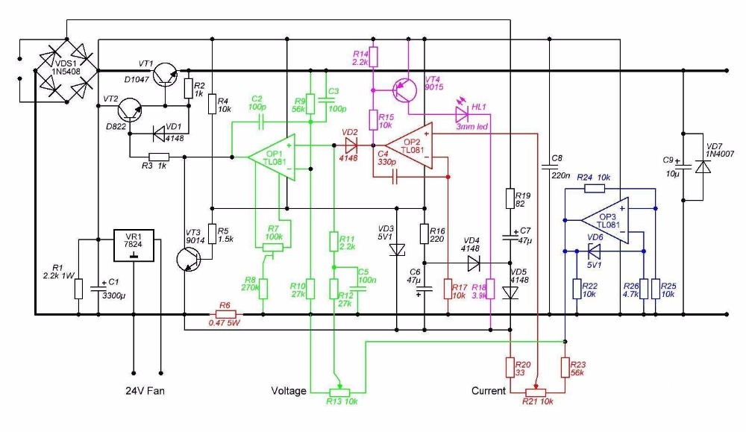
Circuit Diagram for Adjustable DC Power Supply Design
has been shown below:
Input Power Source: This needs an external power source to operate, usually in the form of an AC-to-AC transformer or function generator.
Voltage Regulation: It typically utilizes a combination of components like voltage regulators (such as D822), operational amplifiers, and feedback loops to maintain a stable and adjustable output voltage. You can use a potentiometer or digital controls to set the desired voltage within the 0-30V range.

Slide 4
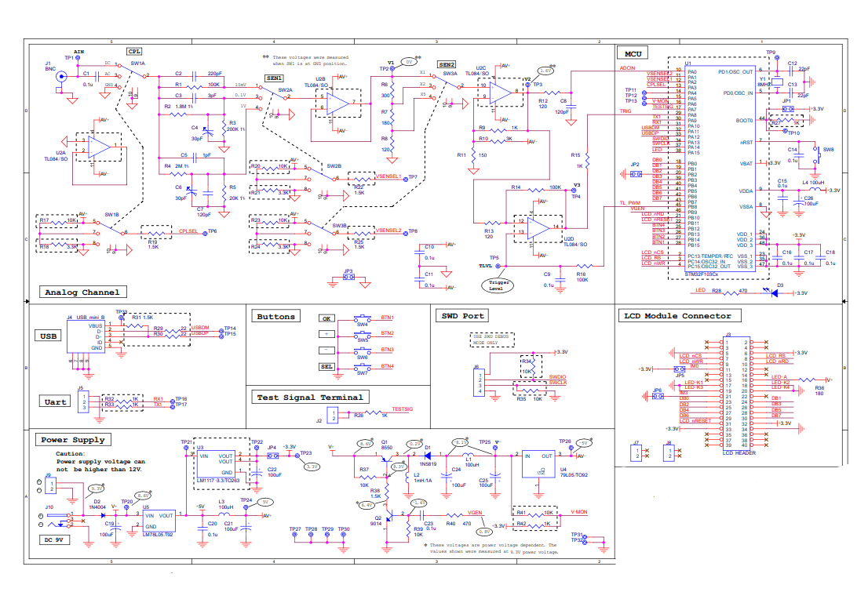
The circuit diagram for the Oscilloscope is shown below:

Slide 5
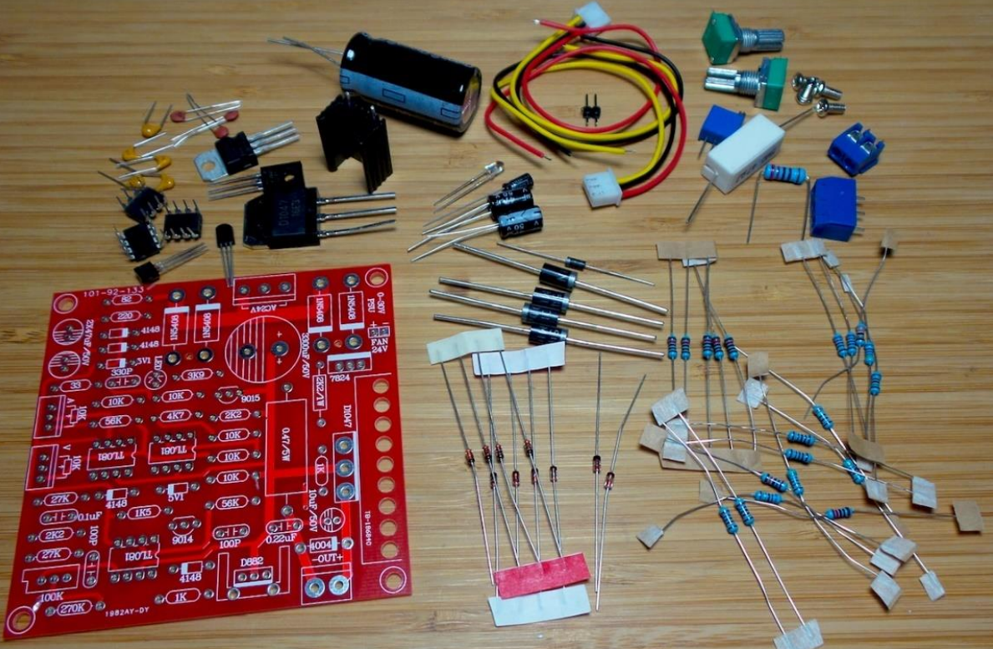
Component Selection:
For the PSU the following types of components were used
Bridge Rectifier diode(4): 1N5408
Filter Capacitors: Electrolytic capacitor (47uF *2 and 10nF)
Voltage Regulator IC: D822 NPN transistor regulator.
Resistors: Various resistors.(220,10k,47k,58k,etc)
Potentiometer: A potentiometer (e.g., 10kΩ)*2
Operational Amplifier (Op-Amp): TL081*3
Power Transistor: A power transistor (e.g.,9014,9015)
Zener Diode: 4148*3, 4004
Heat Sinks
Binding Posts
Holder
Enclosure:
Wiring and Connectors
soldering equipment
Circuit Board/Protoboard

Slide 6

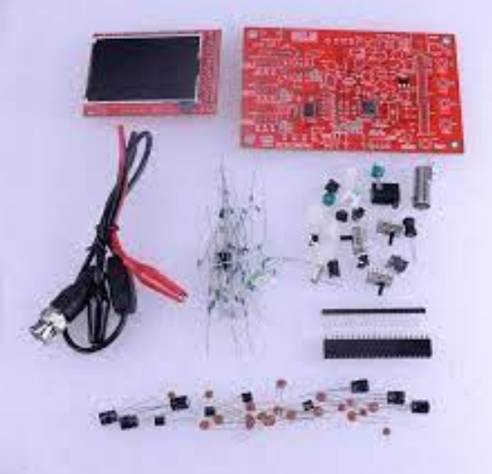
For the oscilloscope the following components are needed
Resistors: 100KΩ 1.8MΩ 200K Ω 2MΩ 20K Ω 300Ω 180Ω 120Ω 1KΩ R10 : 3KΩ R38 : 1.5K Ω 470 Ω 10K Ω
HF-Chokes: 100 H .
Diodes 1N5819 3. Diodes: 1N4004 (or 1N4007)
Crystal 8MHz
USB Socket USB mini – B
Tact Switches SW4, SW5, SW6, SW7, SW
Ceramic Capacitors 1pF 120pF 22 pF
LED:
green Pin header
Transistors 9014
Regulators 79L05 78L05
Capacitor trimmers 5 - 30pF
Power inductor 1mH/0.5A
Electrolytic capacitors 100μ F/16V
Power connector DC005
Pin-header (male) 1 X 3 pin: 1 X 4 pin Pin-header (female) 1 X 2 pin, X 2 0 pin Slide switches 2P3T
BNC connector BNC

Slide 7

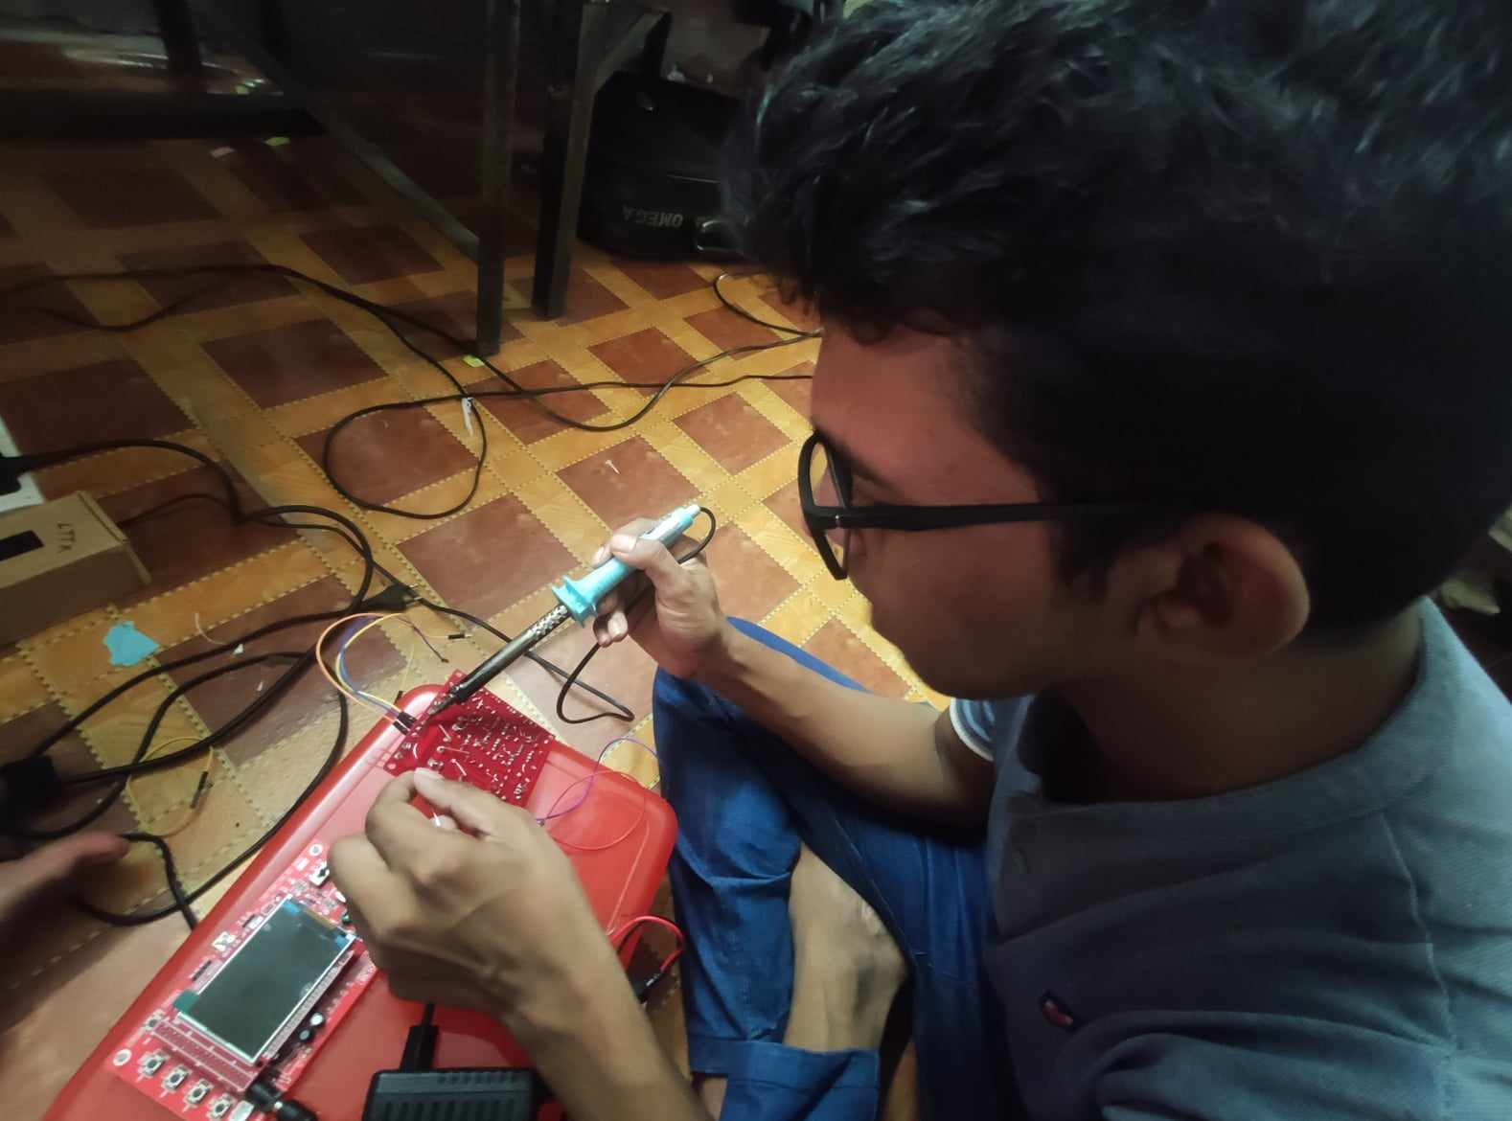
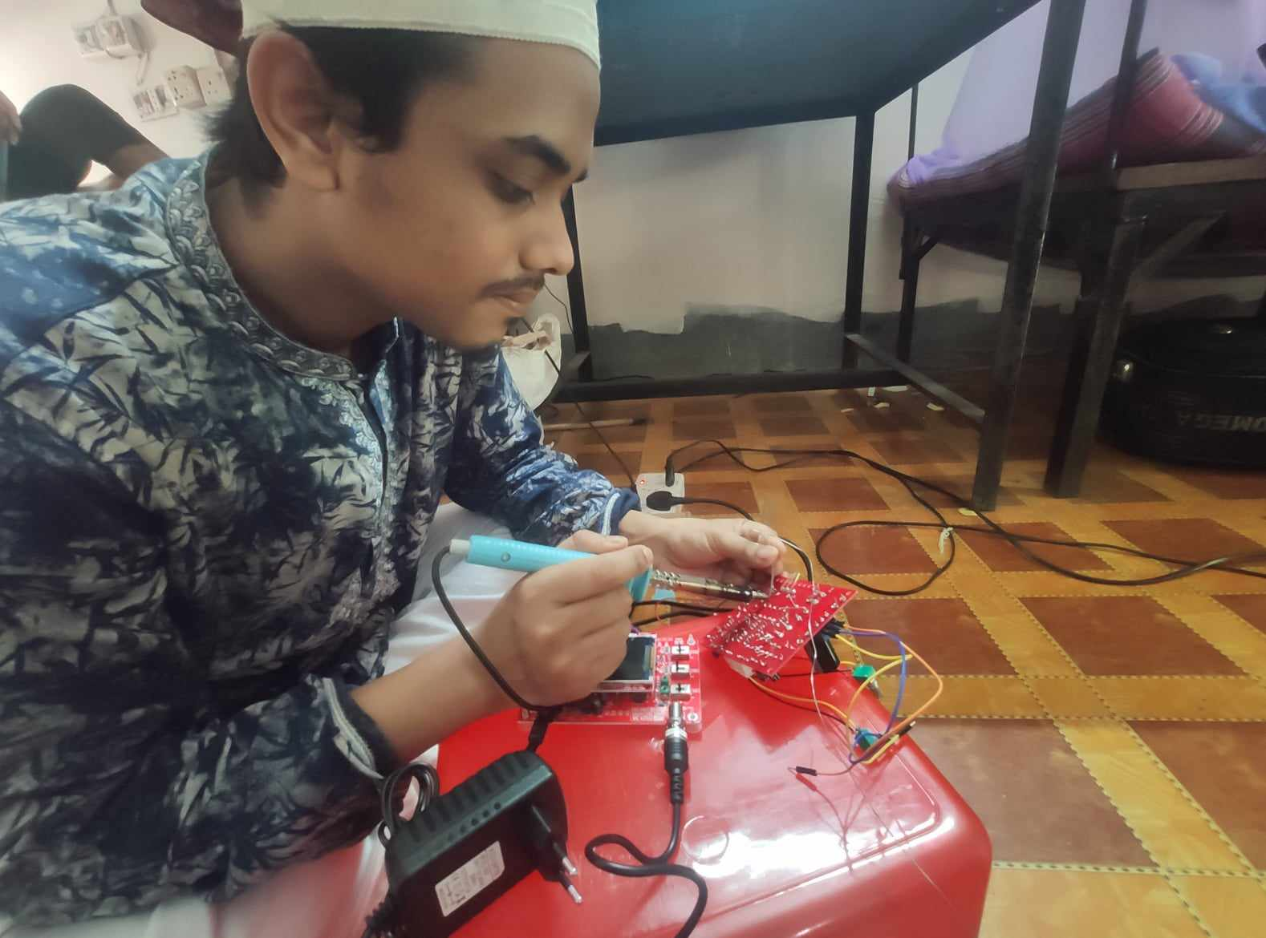
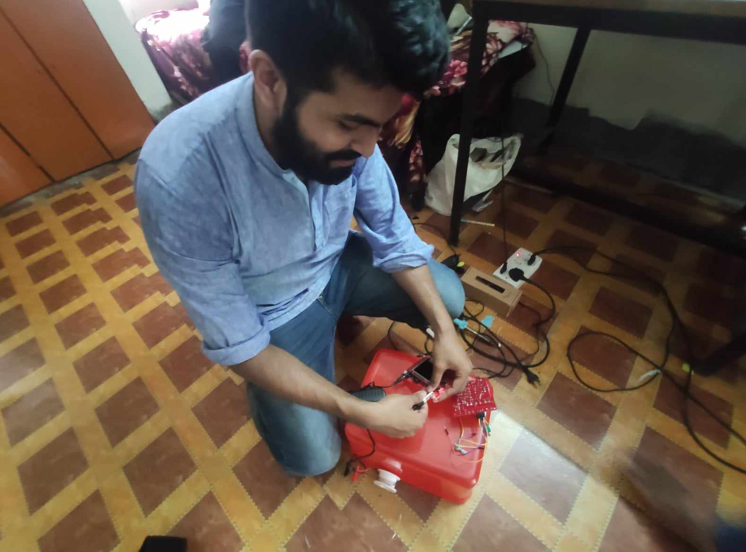
Implementation
We first drew the schematics on proteus. Then we did the pcb design , with help of professionals we printed the pcb board. We bought the necessary components listed above. We soldered the components accordingly. We did this for both the circuits. In the end we had to go through trial and errors in the lab.

Slide 8

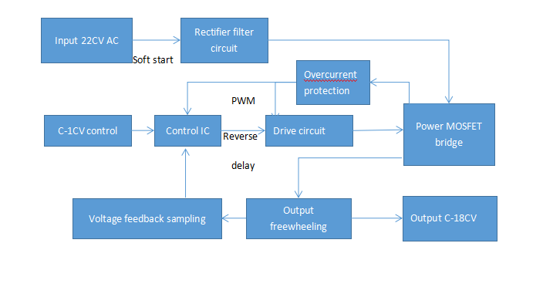
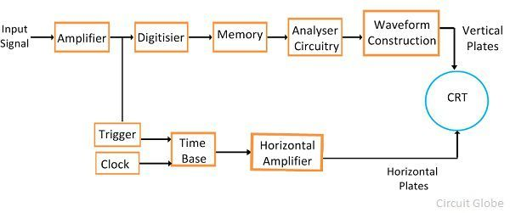
Methodology:
For PSU:
For the oscilloscope:

Slide 9
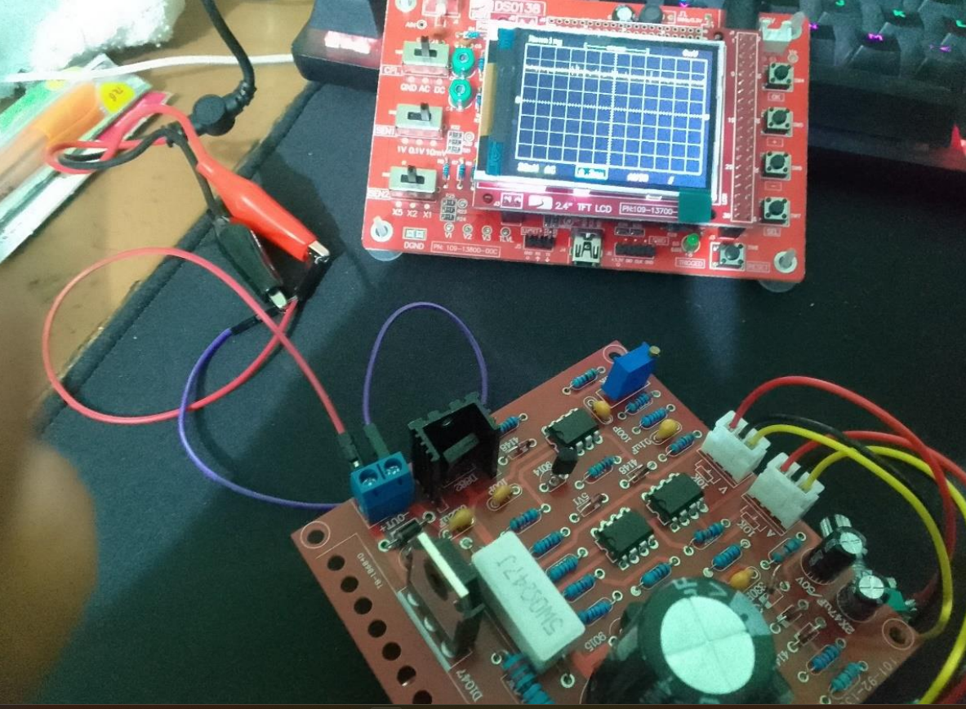
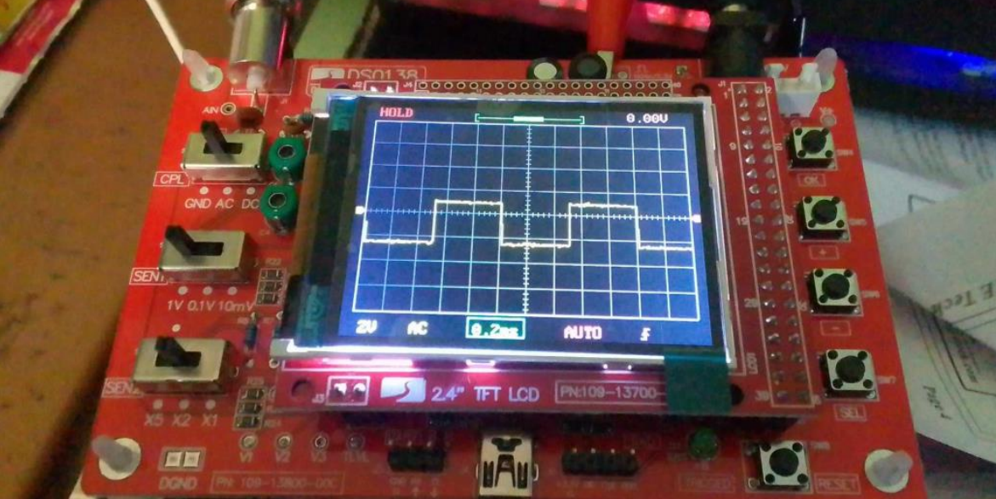
Performance Assessment:
We tested the circuits in various ways including:
- Voltage and current regulation and adjustment on the power supply.
- Testing the power supply's short
-circuit protection.
- Signal generation and waveform visualization on the oscilloscope.
- Accuracy and precision assessments of voltage and current measurements.
The PSU output DC gave us some noise which we thought to address it by changing the electrolytic capacitors. The oscilloscope had to be calibrated with the test signal and signal form frequency generator

Slide 10
Budget analysis:
Power Supply Components (in Taka):
Transformer (0-30V, 5A): 3000 Tk
2. Bridge Rectifier: 100 Tk
3. Filter Capacitors (4700µF, 50V): 500 Tk
4. Voltage Regulator IC (LM317T or LM338T): 200 Tk
5. Resistors and Potentiometer: 300 Tk
6. Operational Amplifier (Op-Amp): 150 Tk 7.
Power Transistor: 100 Tk 8. Zener Diode: 50 Tk
9. Diodes: 50 Tk
11. Digital Voltmeter/Ammeter: 500 Tk
12. Switches and Binding Posts: 200 Tk
16. Wiring and Connectors: 150 Tk
17. Circuit Board/Protoboard: 300 Tk
Total Cost of Power Supply Components: 3150Tk
Oscilloscope Components (in Taka):
Resistors: 500 Tk
2. IC STM32F103C8: 400 Tk
3. IC TL084: 200 Tk
4. IC LM1117-3.3: 100 Tk
5. Other Passive Components: 300 Tk
6. 2.4-inch Color TFT LCD: 1000 Tk
7. Enclosure: 500 Tk 8. Wiring and Connectors: 200 Tk
9. Circuit Board/Protoboard: 400 Tk T
Total Cost of Oscilloscope Components: 2100Tk

Slide 11
Conclusion and Future Enhancements:
While our project has successfully constructed an oscilloscope and an AC/DC power supply with impressive specifications, there is still room for further improvement and expansion
For PSU:
Digital Interface
2. Multiple Output Channels
3. Enhanced Safety Features
For Oscilloscope:
Multi-Channel Capability
Higher Analog Bandwidth
Advanced Triggering Options

Slide 12
Thank you

